Slide 1
Markov Chains in Baseball
Joe Guilfoyle
Probability

Slide 2
Markov Chains Explained
A Markov analysis looks at a sequence of events, and analyzes the tendency of one event to be followed by another.
Markov Chains are useful for analyzing random events that are dependent on only the previous event
  Not useful for independent events such as coin flips
The "output chain" statistically reflects the transition probabilities from one state to the next.

Slide 3
Markov Illustration
http://www.doctornerve.org/nerve/pages/interact/mrkvform.shtml
Input: “the boy and the dog went to the park.”
There is a 33.3% chance that either “boy”, “dog”, or “park” will follow “the” in the output.
The phrase “boy went” will never occur in the output because it never occurred in the input.

Slide 4
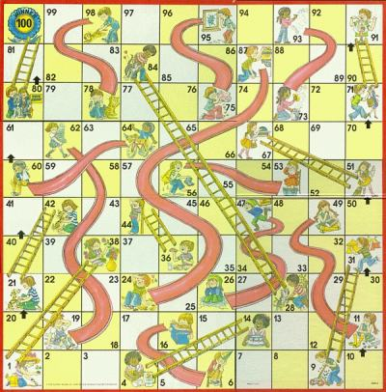
Applications of Markov Chains
Physics
Chemistry
Social Sciences
Economics
Music
Board Games
And of course…

Slide 5
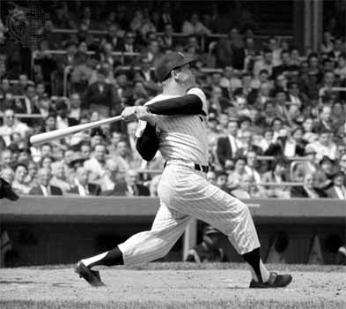
Baseball!
A baseball game is a set of transitions, each initiated by plate appearances

Slide 6
Method
There are 25 possible game situations
  8 distributions of base runners: a player either is or is not on each base (2³ = 8)
  There are either zero, one, or two outs for each base runner scenario (3*8 = 24)
  The final state, where there are 3 outs, is called the absorbing state
    A state is called absorbing if it is impossible to transition out of this state.

Slide 7
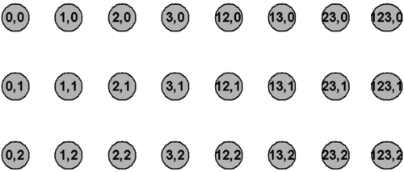
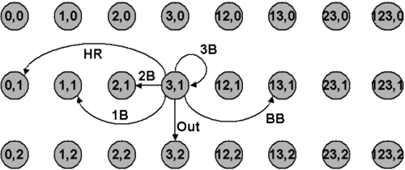
Method
Figure 1
Figure 2

Slide 8
Method
A : do not increase the number of outs
B : increase the number of outs by 1 but do not end with 3 outs
C : increase the number of out from 0 to 2
D : vector probability from 0 to 3 outs
E : vector probability from 1 to 3 outs
F vector probability from 2 to 3 outs
0: represent transitions that decrease the number of outs

Slide 9
Method
First 8 columns represent transition states with 0 outs
Second 8 columns represent transition states with 1 out
Third 8 columns represent transition states with 2 outs
Final column represents transitions to the absorbing 3 outs state
Rows represent transition probabilities from these respective states

Slide 10
Example
Consider “Batter A” who only hits singles and has a batting average of .300
At the start of the inning there are 0 outs and 0 runners on base
There are two possible end states
  (1 on first, 0 outs) with a probability of 0.3
  (0 on base, 1 out) with a probability of 0.7
Let’s consider end state 1.

Slide 11
Example
Now suppose “Batter B” (who also only hits singles) comes to the plate…
  Batter makes an out and runner stays where he is
  Batter makes an out and runner advances
  Batter makes a hit and runner advances to second
  Batter makes a hit and runner advances to third
  Batter grounds in to a double play

Slide 12
Example
Using Batter B’s batting average, we can work out the probabilities of each end state
This process is repeated for all start and end states
http://www.tangotiger.net/markov.html

Slide 13
Runs Scored
  One goal of using Markov chains to predict and then maximize the number of runs scored.
  Certain transitions result in runs
  E.g. A transition from the state (12,0) to (2,0) in a single at-bat requires that two runners score.

Slide 14
Batting Order
Adjustments to the batting order
  Particular batting orders are optimal for scoring the maximum number of runs
  Typically, your best batter is 2nd, 3rd, or 4th in the lineup with your other top batters filling in the other beginning lineup spots.
  Worse batters should be placed towards the back of the lineup

Slide 15
Batting Order
Further analysis of run scoring can provide an optimal lineup of the 9! possibilities
Intuitively, first innings have the most number of runs scored and second innings have the least
Variation in the number of runs per inning decreases as the game goes on

Slide 16
Trades
The Markov chain method can be used to calculated the expected increase or decrease of team wins as the result of a trade
  In 1989, the Mets finished 2nd in their division and the Cardinals finished 3rd
  A trade was simulated between Milt Thompson of the Cardinals, a good singles hitter, and Darryl Strawberry of the Mets, a good slugger.
  Using the Markov chain method, this trade was shown to increase the Cardinals’ runs by 11 for the season and wins by 1.5
  Meanwhile the Mets would have had 13 fewer runs and would have lost 1.7 more games
  This would have moved the Cardinals to first and the Mets to third.

Slide 17
Sources
http://archive.ite.journal.informs.org/Vol5No1/Sokol/Sokol.pdf
http://m.njit.edu/~bukiet/Papers/ball.pdf
http://www.doctornerve.org/nerve/pages/interact/markhelp.htm
http://www.hardballtimes.com/main/article/introducing-markov-chains/
http://www.pankin.com/markov/theory.htm

